Slide 1
Edge Autonomous Portal (MEPM-FE)
- Vidyashree Rama(v00270735)

Slide 2
Requirement description
Edge portal enables users to deploy/terminate/monitor applications in host, independent of mecm/center.
Story:
【MECM】MECM 支持本地边缘自治 Edge Autonomous(id=I2EB7C)
【MECM】MECM Edge Portal integrate with MEP portal(id=I2P7T7)
【MECM】MECM APPO/Inventory support synchronize data from edge.(id=I2P7RL)
Effort Estimation:
No | Modules | Effort
1 | Mepm-fe | 4k
2 | applcm | 1k
3 | Inventory/appo | 1k
4 | apprulemgr | 1k

Slide 3
EdgeGallery(MECM) Architecture Impact
Management
Management
Common Services
AppO
Common Services
AppO
APM
APM
1. New module mepm-fe has to be added to support edge portal
2. Applcm to support required api changes to display apps instantiated and batch terminate
3. Changes in inventory/appo/applcm-be to support syncronization
4. App rule mgr to support to display app rules configured and maintain app rule mgr in database for syncronization.
Platform Manager
Platform Manager
Security Services
Security Services
Inventory
Logging
Logging
Infra Manager
Infra Manager
Placement
Placement
Policy
DB etc.
DB etc.
MEPM
MEPM
MEPM-FE
Element management
AppLCM
App-rule-mgr
Element management
LCM Controller
LCM Controller
LCM Controller
LCM Controller
K8s plugin
K8s plugin
Future plugin
Future plugin
K8s/Future VIM
MEP
Code change
New module

Slide 4
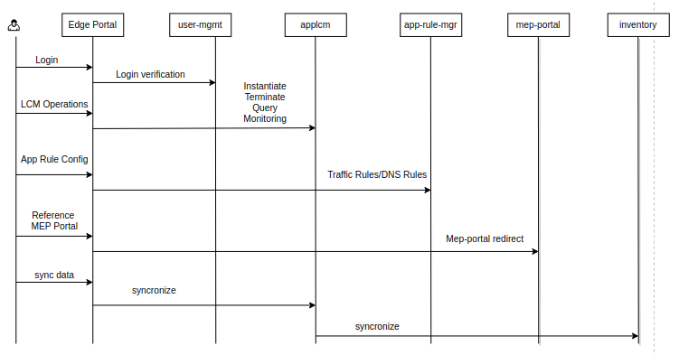
Interaction with other modules
Open point: Interaction with user-mgmt to be confirmed by architecture team.

Slide 5
Features
Login
Validate using user-mgmt
APPLCM operations
Configure host
Add/Remove kube config file for specific host
Upload new app package and instantiate app
Terminate app
Batch terminate app
Display all apps instantiated
APP Rule management
Display existing app rules
Config new traffic/dns rule
Modify traffic/dns rule
Delete traffic/dns rule
Batch delete traffic/dns rule
MEP Portal Reference
Redirect to MEP Portal
Syncronization between mecm-appo/inventory and lcm controller
Provide a button in mecm portal to syncronize app instance info from edge to mecm-appo/inventory

Slide 6
APPLCM Interfaces
Method | API | RequestBody | Response
POST | lcmcontroller/v1/configuration | Config file | ok/error
DELETE | lcmcontroller/v1/configuration | None | ok/error
POST | lcmcontroller/v1/tenants/:tenantId/app_instances/:appInstanceId/instantiate | App package file | ok/error
POST | lcmcontroller/v1/tenants/:tenantId/app_instances/:appInstanceId/terminate | None | ok/error
GET | lcmcontroller/v1/tenants/:tenantId/app_instances | None | App instance info
GET | lcmcontroller/v1/tenants/:tenantId/hosts/:hostIp/kpi | None | ok/error
GET | lcmcontroller/v1/tenants/:tenantId/hosts/:hostIp/mep_capabilities | None | Mep capabilities
POST | lcmcontroller/v1/tenants/:tenantId/app_instances/batchterminate | List of appinstance id | ok/error

Slide 7
APP-Rule-Mgr Interfaces
Method | API | RequestBody | Response
POST | apprulemgr/v1/tenants/:tenantId/app_instances/:appInstanceId/appd_configuration | AppDRuleModel | ok/error
DELETE | apprulemgr/v1/tenants/:tenantId/app_instances/:appInstanceId/appd_configuration | None | ok/error
PUT | apprulemgr/v1/tenants/:tenantId/app_instances/:appInstanceId/appd_configuration | AppDRuleModel | ok/error
GET | apprulemgr/v1/tenants/:tenantId/app_instances/:appInstanceId/appd_configuration | None | AppDRuleModel

Slide 8
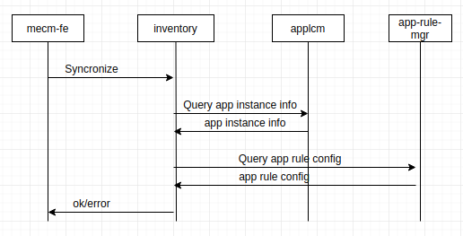
Data Syncronization between cloud and edge
Provide a button in mecm portal to synchronize data from edge.
Prerequisite:
There should be connection between cloud and edge when user/adminstrator is manually synchronizing the database.
Implementation:
When syncronize button is clicked, inventory/appo pulls the information from applcm and update to its database.
WorkFlow:

Slide 9
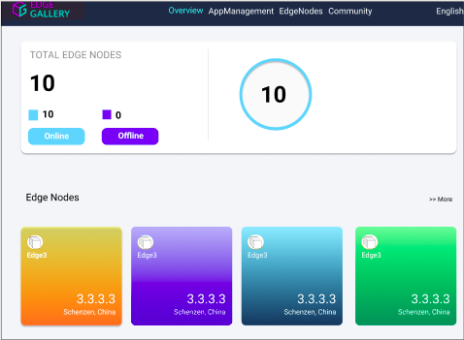
Overview

Slide 10
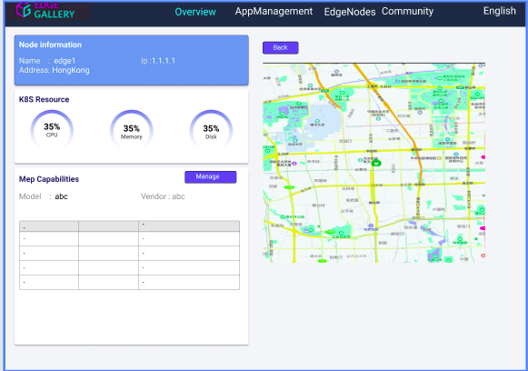
Edge node details

Slide 11
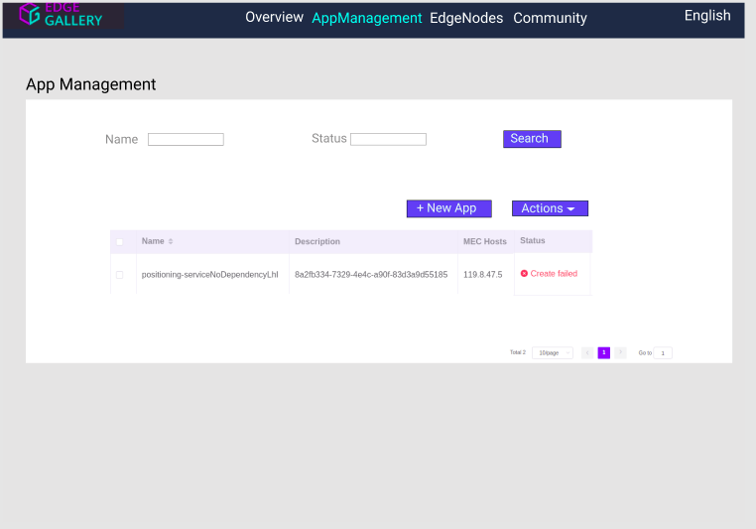
App instance Management

Slide 12
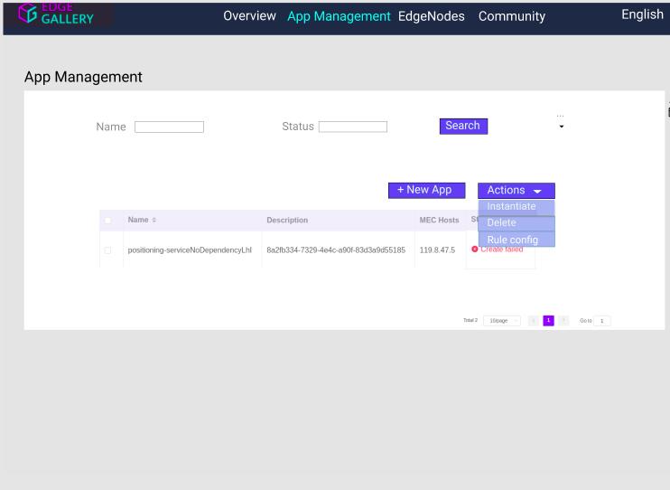
App Instance Management -Actions

Slide 13
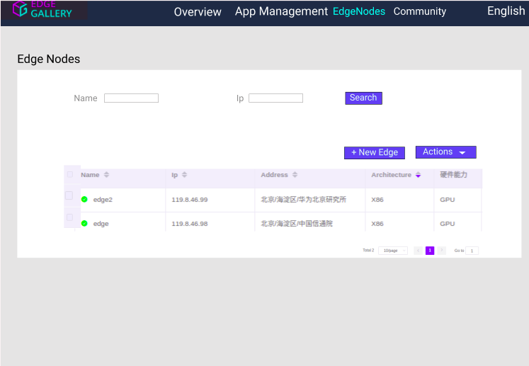
EdgeNodes

Slide 14
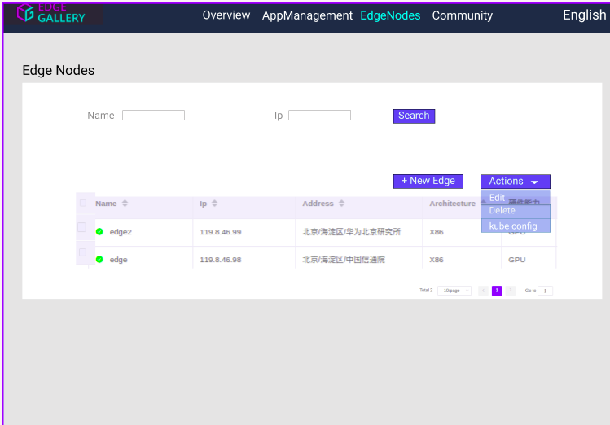
EdgeNodes - Action

Slide 15
Open Points
User-mgmt is not currently available in edge. So login feature can’t be supported.
User will have option to provide tenant id.
If tenant id is not provided, then mepm portal will use default tenant id to support syncronization.

